Slide 1


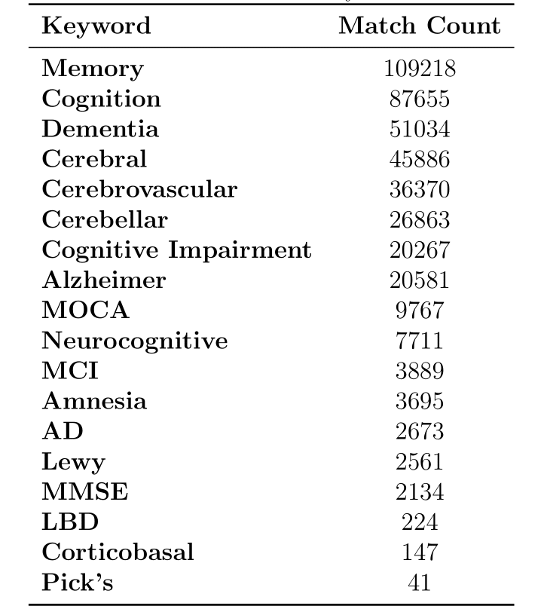
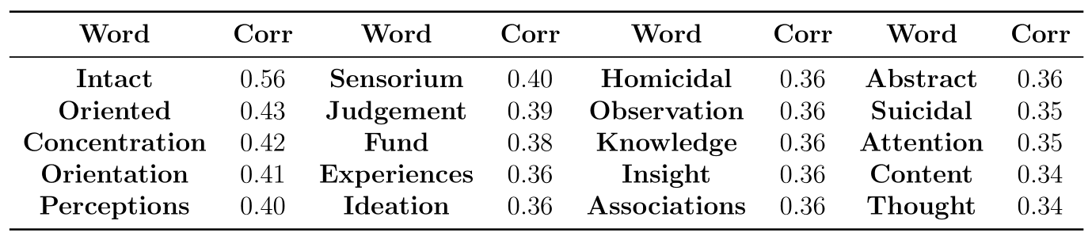
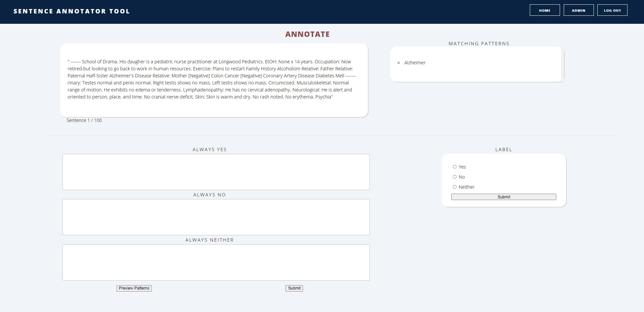
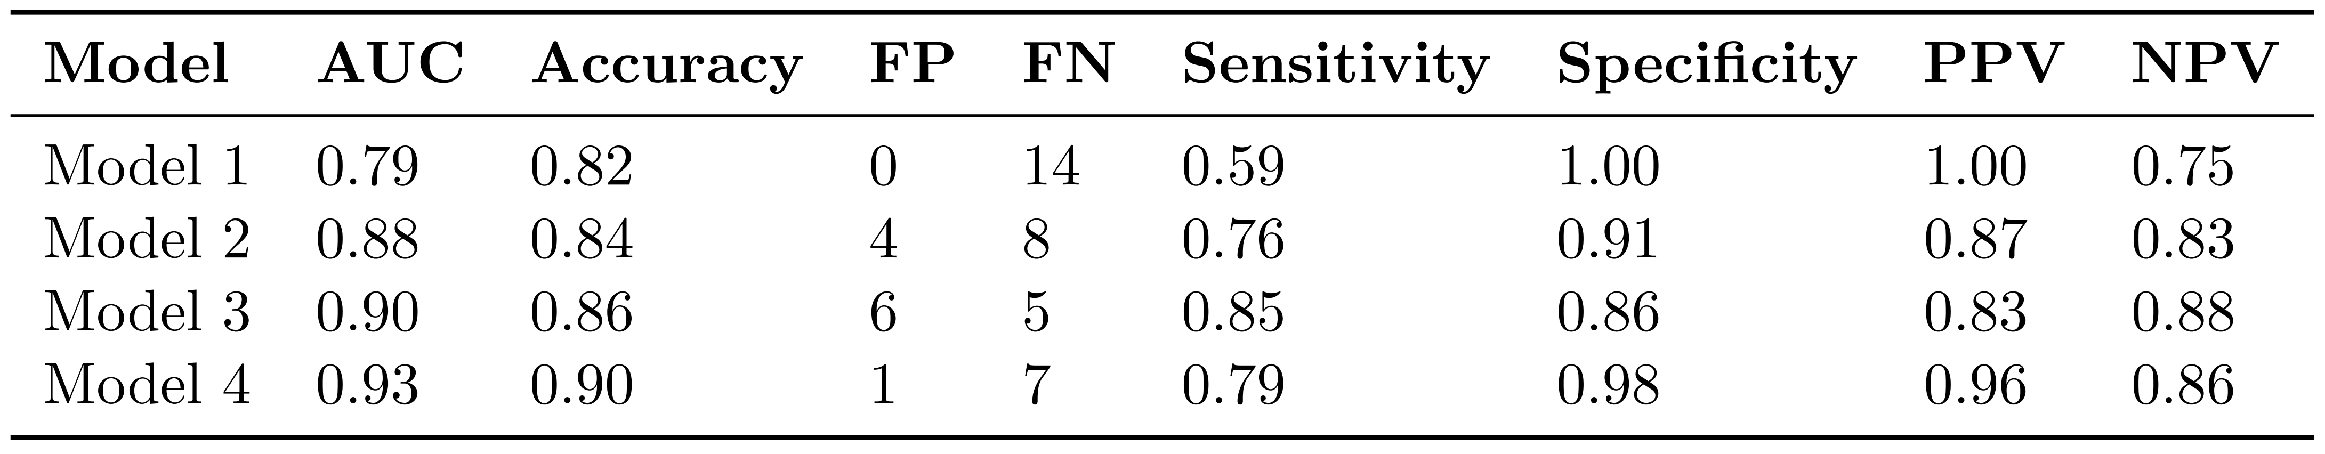
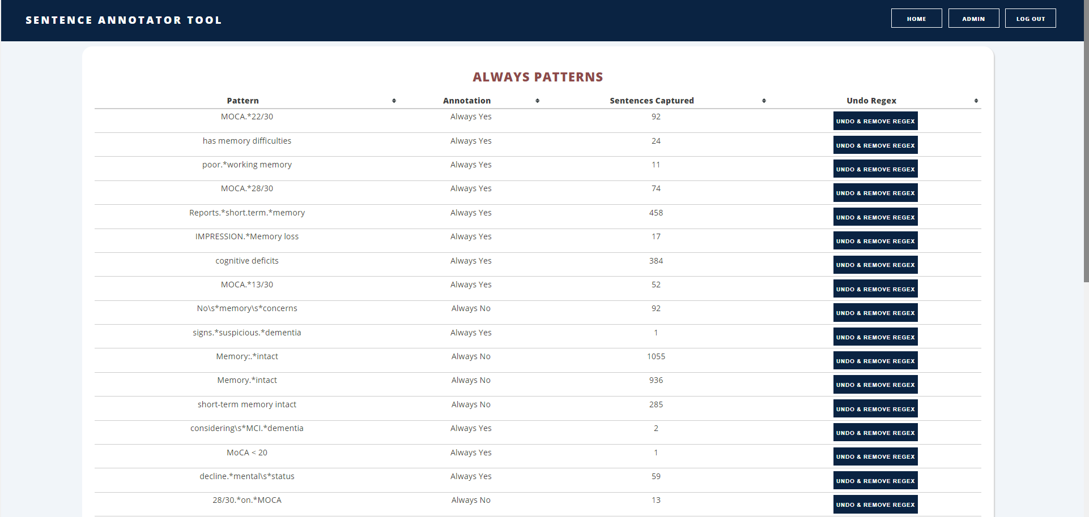
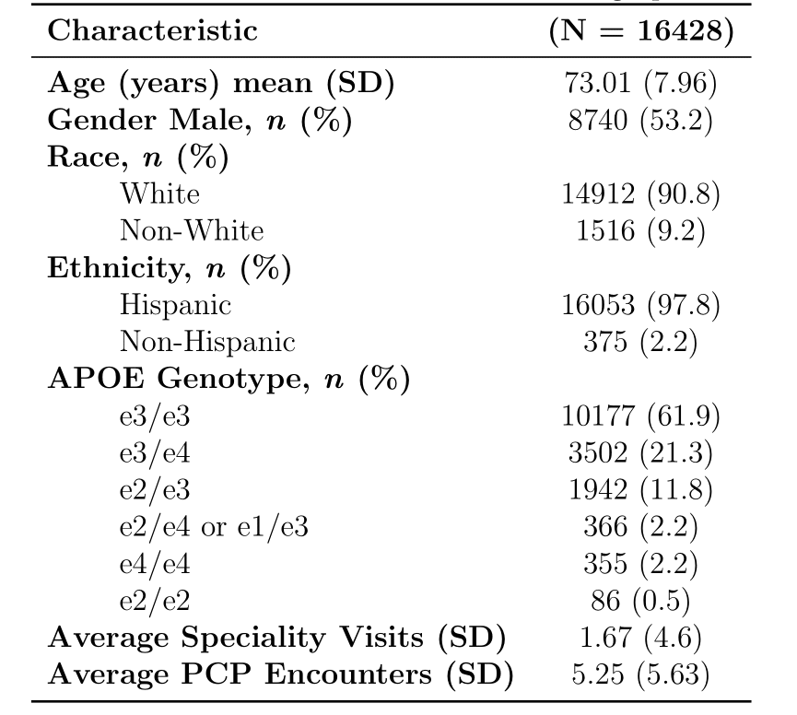
Using Deep Learning to Identify Cognitive Impairment in Electronic Health Records
Tanish Tyagi, Colin Magdamo, Ayush Noori, Mayuresh Deodhar, Zhuoqiao Hong, Dmitry Prokopenko, Rudy E. Tanzi, Deborah Blacker, Bradley T. Hyman, Shibani S. Mukerji, M. Brandon Westover, Sudeshna Das
Mind Data Science Lab, Massachusetts General Hospital and Harvard Medical School, Boston, Massachusetts
ABSTRACT
ANNOTATION TOOL
MODEL 1
Background:
Dementia is under-diagnosed by healthcare professionals—only one in four people who suffer from dementia are diagnosed. Even when a diagnosis is made, it may not be entered as a structured diagnosis code in a patient’s charts. Information relevant to cognitive impairment is often found within electronic health records but manual review of clinician notes by experts is both time consuming and often prone to errors. Automated evaluation of these notes presents an opportunity to label patients with cognitive impairment (CI) in real-world data.
Method:
We selected a cohort of patients from the Mass General Brigham (MGB) healthcare system who were older than 60 years (as of July 13, 2021), had at least one unique encounter with a match of a keyword pertinent to CI, and had APOE genotype data available from the BioBank (N=16,428). We extracted unstructured clinician notes, identified matches to dementia-related keywords, and constructed 800-character sequences from these matches. These sequences were then annotated by neurologists using a web-based annotation tool as 1) Yes, i.e., patient has CI; 2) No i.e., Patient does not have CI; and 3) Neither i.e., sequence has no information on patient’s cognition. We performed TF-IDF (term frequency-inverse document frequency) vectorization on the annotated sequences and selected features based on a term's Pearson correlation coefficient with the outcome. Regularized logistic regression was applied with the annotated cognitive impairment labels. We used different correlation coefficients as thresholds to select features and iterated over different lambda values to determine the optimal lambda value and correlation coefficient threshold.
Results:
The regularized logistic regression model was trained on a dataset comprised of 8,362 annotated sequences from (N=2,417) unique patients using 10-fold Cross Validation stratified across the three cognitive impairment labels. It achieved an area under the receiver operating characteristic curve (AUROC) of 0.94, accuracy of 0.85, sensitivity of 0.81 and specificity of 0.92 on the held-out test set (353 annotated sequences from N=77 unique patients) with a lambda value of 10 and a correlation coefficient threshold of 0.01. We then applied our model to 20K sequences from Y patients. A, B, C% of APOE e2 (e22, e23) were classified as yes, no, and neither. Similarly report for e3 (e33) and e4 (e24,e34, e44).
Conclusion:
We developed a machine learning tool to identify potential patients with cognitive impairment. Future work incudes further improving classification by using deep learning natural language processing (NLP) techniques and obtaining more annotated sequences.
Our annotation tool efficiently presents textual information to memory experts, allowing them to annotate new examples. Currently, we are in the process of manually annotating 5,000 sequences that have been diversified among all keywords. We have used sequences annotated manually and through always patterns to train initial models.
Logistic Regression with Word Vectorization (TFIDF) on Notes
Model 1 found specific words that were highly correlated with outcome of cognitive impairment and used them to create TFIDF vectors for classification.
Table 2. TF-IDF Weights of Top Words Correlated with Prediction Outcome
MODEL 2
Table 3. Model Performance Metrics
MODEL PERFORMANCE COMPARISON
Our model performance table shows an increase in AUC-ROC as our modeling approaches become more expressive.
DATASET
Annotated:
8,656 annotated sequences from (N = 2,417) unique patients
Training/Validation and Test Data:
Split: 0.95 Training/Validation, 0.05 Test
Compute yes, no, neither
Table 1. Demographics of Dataset

